Slide 1

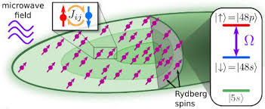




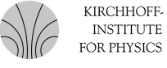
Many-body dynamics of disordered Rydberg spin systems
Martin Gärttner
Project A05 (with M. Weidemüller)
Lunch Seminar, 21.06.2022

Slide 2
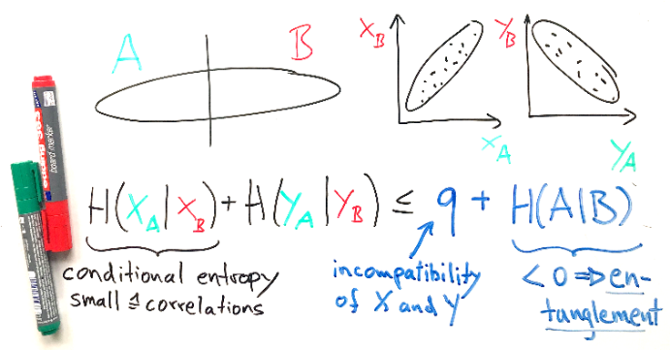
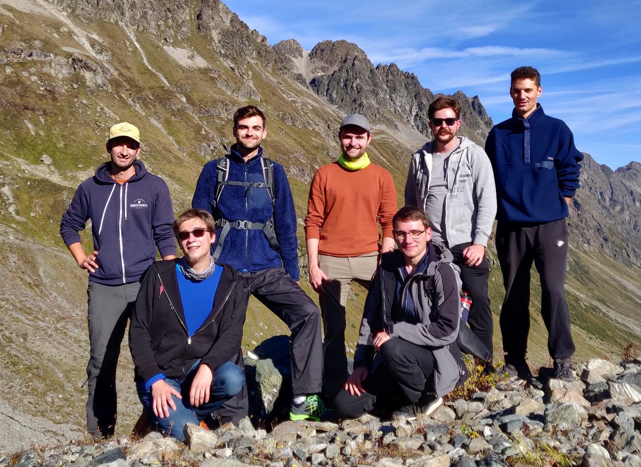
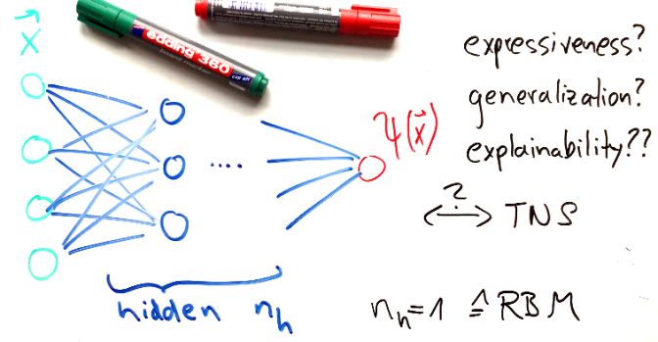
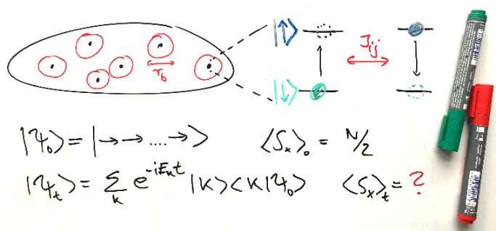
Many-body quantum dynamics group (mbqd.de)
Entanglement detection
How to quantify and detect entanglement in quantum many-body systems?
Neural quantum states
How to efficiently represent quantum many-body states?
Disordered spin systems
When and how do disordered spin systems thermalize?
Inaugural group retreat, Galtür 2021

Slide 3
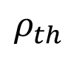
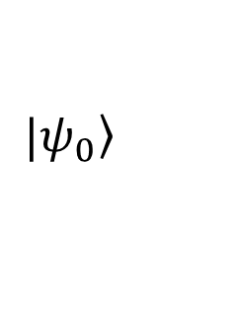
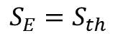
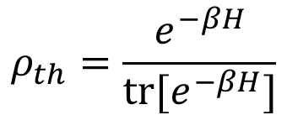
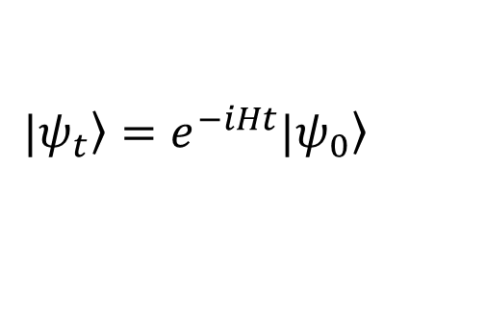
Thermalization in isolated quantum systems
$$|\left.ψ_{t}\right\rangle =e^{−iHt}|\left.ψ_{0}\right\rangle$$
Local subsystems (usually) become thermal at long times
→ Universal behavior in relaxation dynamics?
→ Many-body localization in disordered systems?
?
$$ρ_{th}=\frac{e^{−βH}}{tr[e^{−βH}]}$$
$$|\left.ψ_{0}\right\rangle$$
$$ρ_{th}$$
$$S_{E}=S_{th}$$

Slide 4
Disordered quantum spin systems with dipolar interactions
Realized in many physical systems: Rydberg atoms, cold molecules, NMR systems, NV centers, magnetic atoms,…
Rydberg systems: Collaboration with group of M. Weidemüller.
Disorder in the fields
(standard model of MBL)
Disorder in the couplings

Slide 5
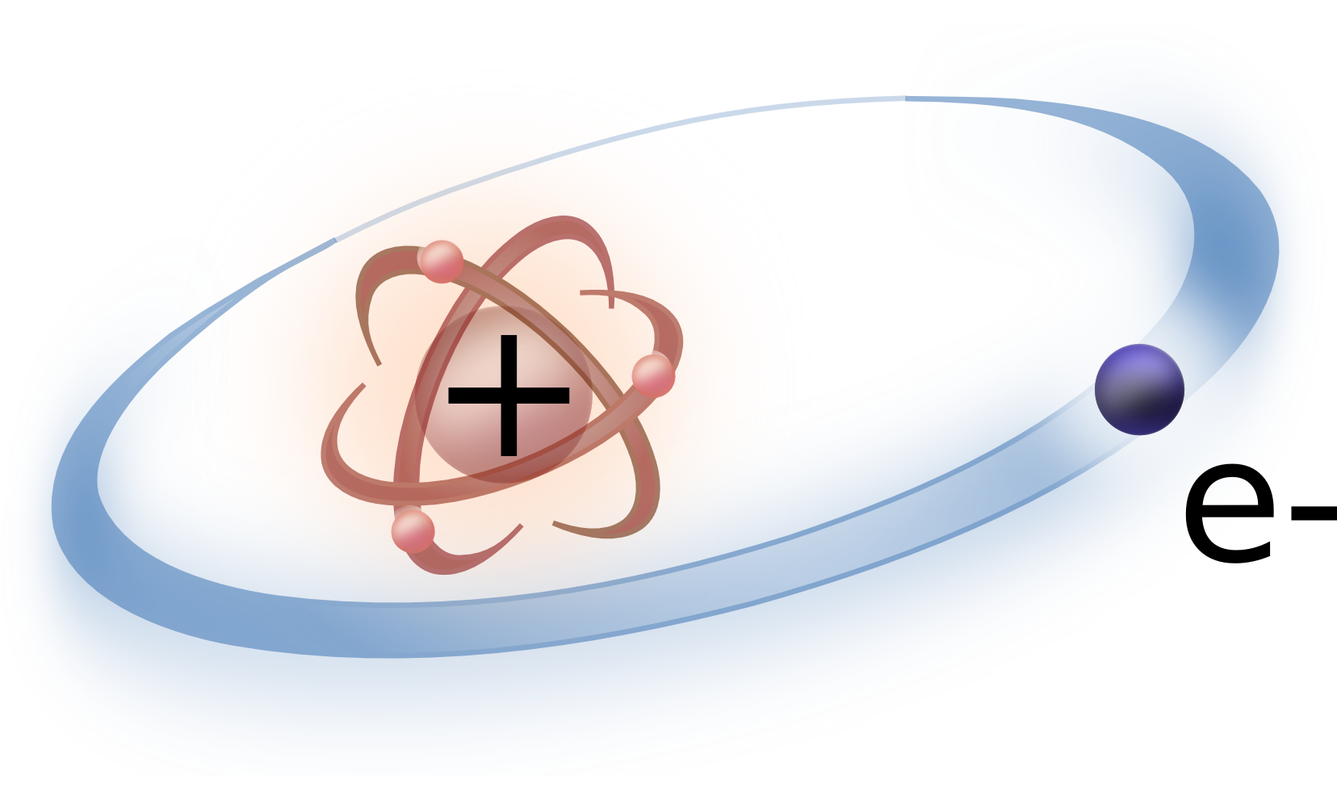
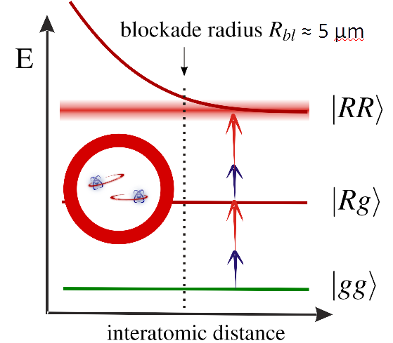
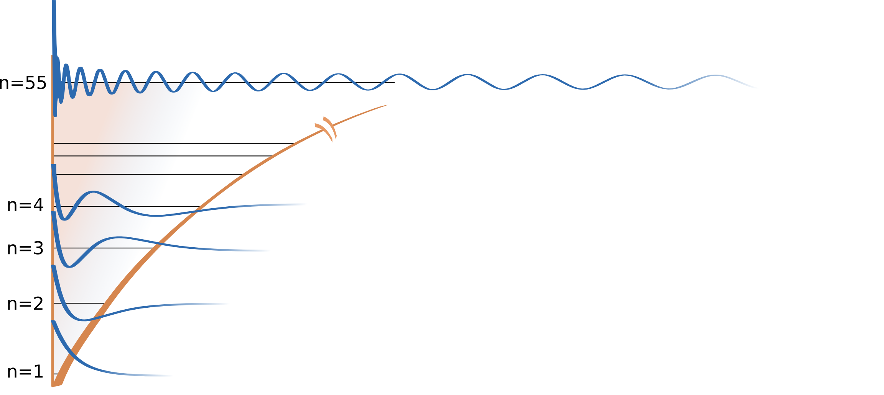
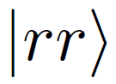
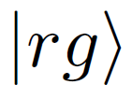
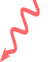
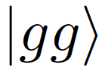
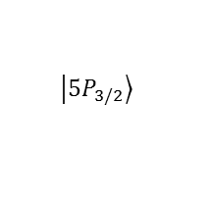
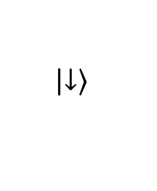
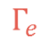
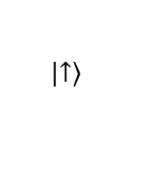
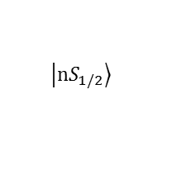
Excitation to Rydberg states
large polarizability
van der Waals
interactions
C₆ / R⁶ ∝ n¹¹
Rydberg state
$$\left|\left.nS_{1/2}\right\rangle \right.$$
Radial wavefunctions
480 nm
$$\left|\left.5P_{3/2}\right\rangle \right.$$
$$Γ_{e}$$
Coulomb potential
$$Γ_{e}$$
780 nm
$$\left|\left.5S_{1/2}\right\rangle \right.$$
r

Slide 6
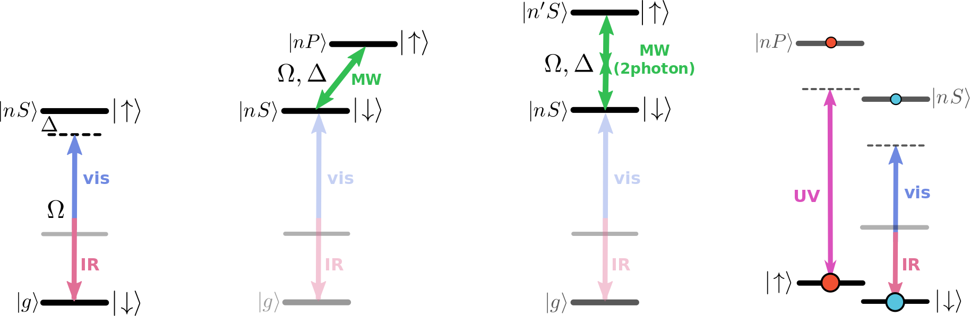
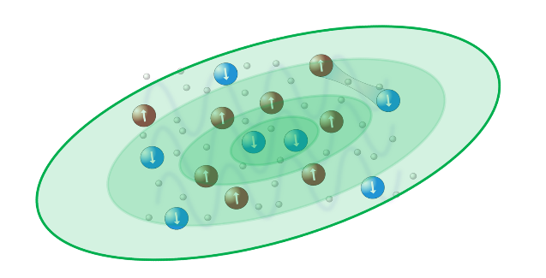
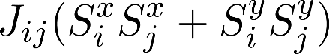
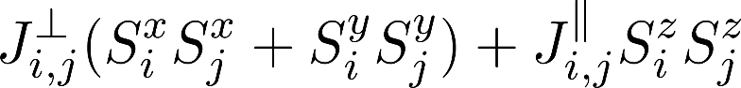
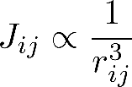
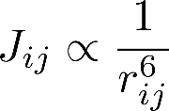
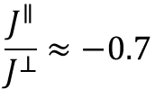
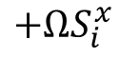
Rydberg spin system with tunable disorder
Random atom positions
Quantum
Ising
Dipolar XY
XXZ
$$+ΩS_{i}^{x}$$
Tunable disorder strength
$$\frac{J^{∥}}{J^{⊥}}≈−0.7$$

Slide 7
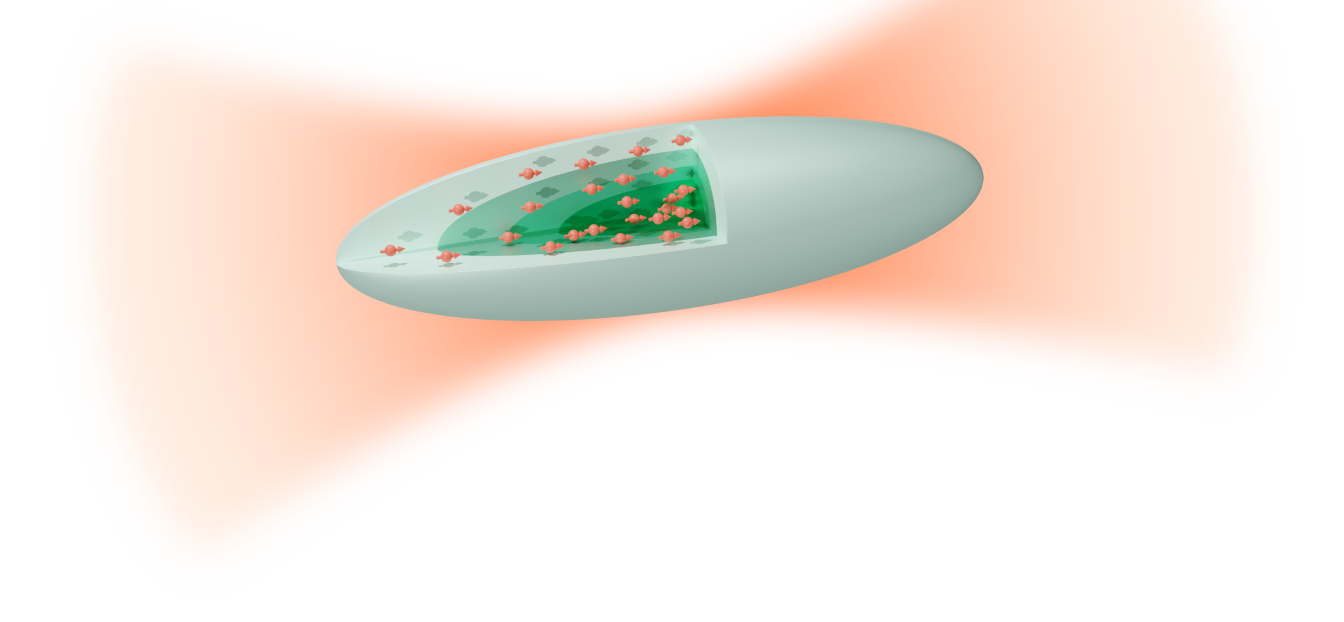
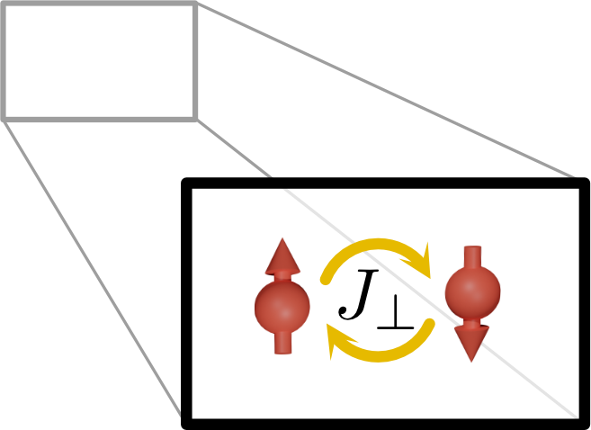
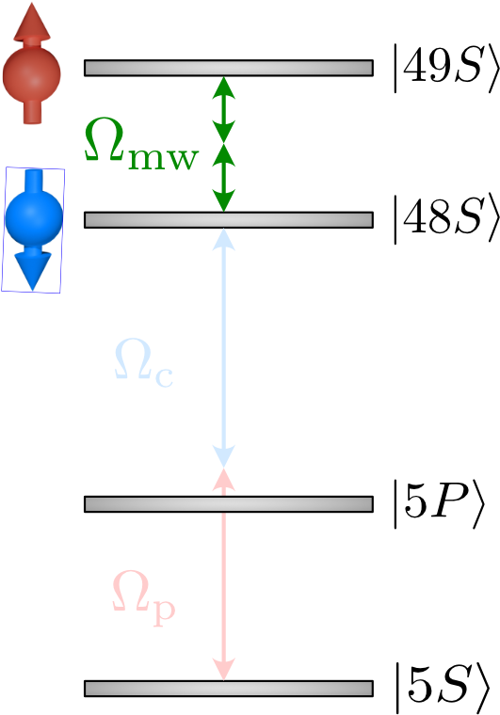
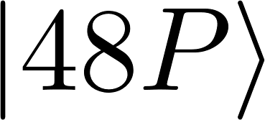
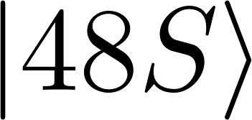
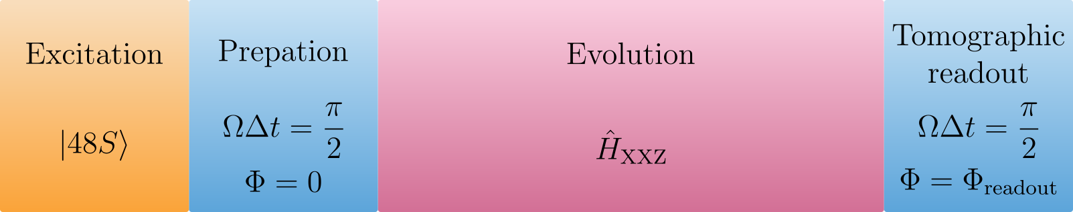
Typical experimental sequence
Laser excitation:
Preparation of 3000 spins
Initial state (no entropy)

Slide 8

Typical experimental sequence
Microwave driving:
Transverse field

Slide 9
Typical experimental sequence
Microwave driving:
Transverse field

Slide 10
Typical experimental sequence
Magnetization measurement:
Selective field ionization

Slide 11
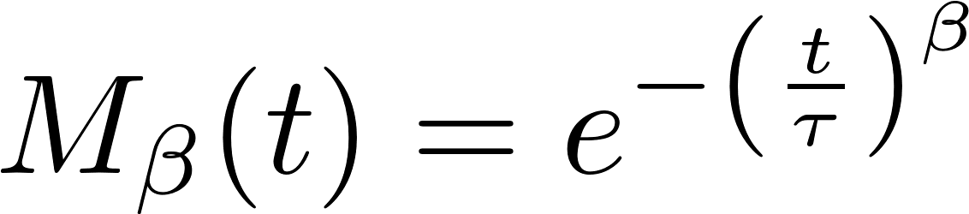
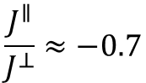
Magnetization decay
$$\frac{J^{∥}}{J^{⊥}}≈−0.7$$
Observation:
Stretched exponential
References:
A. Signoles, T. Franz et al., PRX 11, 011011 (2021)
P. Schultzen et al., PRB 105, L020201 (2022)
P. Schultzen et al., Phys. Rev. B 105, L100201 (2022)

Slide 12
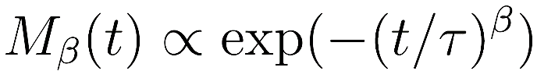
“Universal” stretched exponential relaxation
Different densities
Truncated Wigner simulations:
Stretched exponential fit:
Exponent β constant below a certain
disorder strength (“universal” regime).
fitted stretch power: β= 0.32(2)
How universal is this really?
Analogy to classical spin glasses

Slide 13
Ising model: Analytical solutions
PRB 105, L020201 (2022)
Emch-Radin solutions :
G. G. Emch, J. Math. Phys. 7, 1198 (1966)
C. Radin, J. Math. Phys. 11, 2945 (1970)
Evaluate ensemble average:
3D, α=6, N=1300, small blockade
Assumptions: small blockade, large N
Integral factorizes
→ Stretched exponential

Slide 14
Ising model: Purity decay
Emch-Radin solutions:
Single spin purity (Renyi entanglement entropy):
Different mechanisms:
- Dephasing due to disorder
- Entanglement buildup
Analogy to classical spin glasses, open systems:
Sum of exponentials vs. product of oscillations

Slide 15
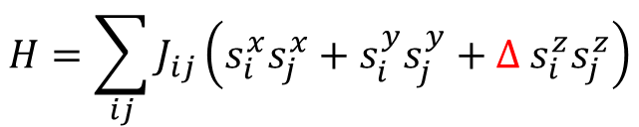
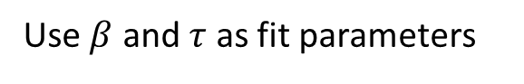
Systematic dTWA study
$$H=\sum_{ij}{J_{ij}\left(s_{i}^{x}s_{j}^{x}+s_{i}^{y}s_{j}^{y}+Δ s_{i}^{z}s_{j}^{z}\right)}$$
Conclusion: Stretched exponential good phenomenological description
Strong disorder RG picture?
Use $β$ and $τ$ as fit parameters

Slide 16
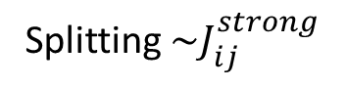
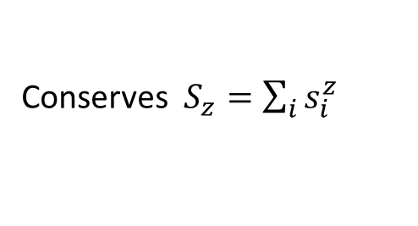
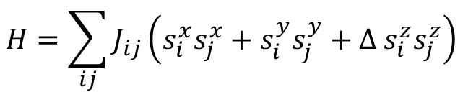
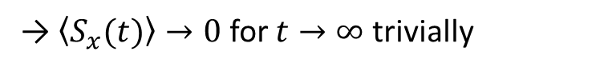
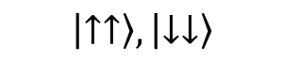
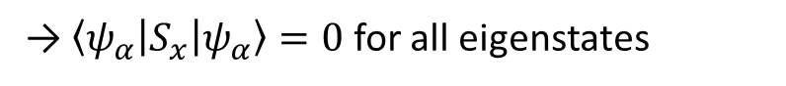
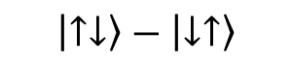
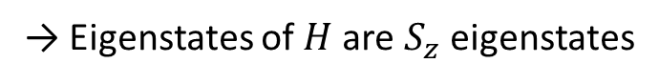

Does the system relax to a thermal state?
Conserves $S_{z}=\sum_{i}{s_{i}^{z}}$
$$H=\sum_{ij}{J_{ij}\left(s_{i}^{x}s_{j}^{x}+s_{i}^{y}s_{j}^{y}+Δ s_{i}^{z}s_{j}^{z}\right)}$$
→ Eigenstates of $H$are $S_{z}$ eigenstates
→ $\left\langle ψ_{α} | S_{x} | ψ_{α}\right\rangle =0$ for all eigenstates
$$\left|↑↓\right\rangle +\left|↓↑\right\rangle$$
→ $\left\langle S_{x}(t)\right\rangle →0$ for $t→∞$ trivially
$$\left|↑↑\right\rangle ,\left|↓↓\right\rangle$$
Splitting $\sim J_{ij}^{strong}$
$$\left|↑↓\right\rangle −\left|↓↑\right\rangle$$
Disorder in the couplings
→ Pair localization?
→ Study spectral and eigenstate properties
Strongly interacting pairs as local integrals of motion?

Slide 17



Spectral statistics
Random positions
+ blockade
…
Ergodic (random matrix theory)
$$ΔE_{n}$$
$$ΔE_{n−1}$$
Localized (Poisson)
…
$$r_{n}=\frac{min⁡(ΔE_{n} ,ΔE_{n−1} )}{max⁡(ΔE_{n} ,ΔE_{n−1} )}$$
Local conserved quantities
= strongly interacting pairs
disorder strength

Slide 18


Eigenstate entanglement
A
B
$$S_{E}=−tr[ρ_{A}\log{ρ_{A}}]$$
$$ρ_{A}=tr_{B}[ρ_{AB}]$$
disorder strength

Slide 19








Thoules parameter
$$V=σ_{N/2}^{z}$$
$V$ local operator
$$V_{mn}=\left\langle φ_{m} | V | φ_{n}\right\rangle$$
$$G_{n}=\ln{\frac{\left|V_{n,n+1}\right|}{E_{n+1}−E_{n}}}$$
$$V=\sum{V_{r}^{α_{1}..α_{r}}τ_{1}^{α_{1}}..τ_{r}^{α_{r}}}$$
$$τ_{i}^{z}=Uσ_{i}^{z}U^{†}$$
ETH:
$$\left\langle G\right\rangle ∝L$$
MBL:
$$\left\langle G\right\rangle ∝−L$$
Serbyn et al., Phys. Rev. X 5, 041047 (2015)
Confirms localized pair picture
Disorder strength

Slide 20




Experimental observation
Spectral and eigenstate properties are not measurable
→ External field dependence of global magnetization!
$$Ω$$
Strong field
Spin locking effect:
Weak field
No field
Solid lines: semiclassical DTWA simulations

Slide 21
Long-time magnetization
Cusp feature
Asymmetry
Magnetization > 0
→ Thermal?

Slide 22









Thermal ensembles
$$Ω$$
Time evolution:
Numerical simulation (14 spins in 3d)
Equilibration
$$⇔$$
Diagonal ensemble:
Eigenstate occupation number (EON) ${\left|C_{α}\right|}^{2}$
$$C_{α}$$
Eigenstate expectation value (EEV) $A_{αα}$
Thermalization
$$⇔$$
Microcanonical ensemble:
Fails to thermalize!

Slide 23





Eigenstate thermalization
Time evolution:
Equilibration
$$⇔$$
Diagonal ensemble:
Eigenstate occupation number (EON) ${\left|C_{α}\right|}^{2}$
$${\left|C_{α}\right|}^{2}$$
$$C_{α}$$
Eigenstate expectation value (EEV) $A_{αα}$
$$A_{αα}$$
Thermalization
$$⇔$$
$$⟨A⟩$$
ETH
Microcanonical ensemble:
energy

Slide 24




Eigenstate thermalization?
$$Ω$$
Time evolution:
Equilibration
$$⇔$$
Diagonal ensemble:
Eigenstate occupation number (EON) ${\left|C_{α}\right|}^{2}$
$$C_{α}$$
Eigenstate expectation value (EEV) $A_{αα}$
Thermalization
$$⇔$$
ETH
Microcanonical ensemble:

Slide 25
XX-model case
$$Ω$$
High density regime thermal!
→ Transition in between
Strong disorder
Weak disorder

Slide 26
More on disordered spin systems
Measuring operator spreading with out-of-time-ordered correlators
→ Maximilian Müllenbach
Engineered dissipation, fluctuation-dissipation relations
→ Andre Salzinger, with Kevin Geier (Hauke group)
Hamiltonian engineering
→ Sebastian Geier
Floquet phases of matter
→ Niklas Euler
STRUCTURES exploratory project with Razvan Gurau
Science 374, 1149 (2021)

Slide 27







Acknowledgements
Thank you!
Rydberg experiments:
Theory:
Mathias
Weidemüller
Gerhard Zürn
Adrien Signoles
Clément Hainaut
Titus Franz
Sebastian Geier
+ Philpp Schultzen
Adrian Braemer

Slide 28
Summary
Universal slow relaxation of magnetization
Failure of thermalization due to pair localization
Observation via transverse field dependence
Localization-delocalization transition

